Slide 1
Enhanced Entity-Relationship (EER) Model
Dr. Anand Kumar M
Assistant Professor,
NIT-K, Surathkal

Slide 2
Outline
EER
Sub/super class-Inheritance
Specialization and Generalization
Constraints and Characteristics
Example

Slide 3
The Enhanced Entity-Relationship (EER) Model
Enhanced ER (EER) model
ER sufficient for traditional DB applications.
Created to design more accurate database schemas
Reflect the data properties and constraints more precisely
More complex requirements than traditional applications

Slide 4
EER
EER = Conceptual Data Model + Semantic Data Model
Knowledge Representation in Artificial Intelligence
Object Modeling in Software Engg

Slide 5
Subclasses, Superclasses, and Inheritance
EER model includes all modeling concepts of the ER model
In addition, EER includes:
Subclasses and superclasses
Specialization and generalization
Category or union type
Attribute and relationship inheritance

Slide 6
Subclasses, Superclasses, and Inheritance (cont’d.)
Enhanced ER or EER diagrams
Diagrammatic technique for displaying these concepts in an EER schema
Subtype or subclass of an entity type
Subgroupings of entities that are meaningful
Represented explicitly because of their significance to the database application

Slide 7
Subclasses, Superclasses, and Inheritance (cont’d.)
Terms for relationship between a superclass and any one of its subclasses
Superclass/subclass
Supertype/subtype
Class/subclass relationship
Type inheritance
Subclass entity inherits all attributes and relationships of superclass

Slide 8
Subclasses and Superclasses (1)
An entity type may have additional meaningful subgroupings of its entities
Example: EMPLOYEE may be further grouped into:
SECRETARY, ENGINEER, TECHNICIAN, …
Based on the EMPLOYEE’s Job
MANAGER
EMPLOYEEs who are managers
SALARIED_EMPLOYEE, HOURLY_EMPLOYEE
Based on the EMPLOYEE’s method of pay
EER diagrams extend ER diagrams to represent these additional subgroupings, called subclasses or subtypes

Slide 9
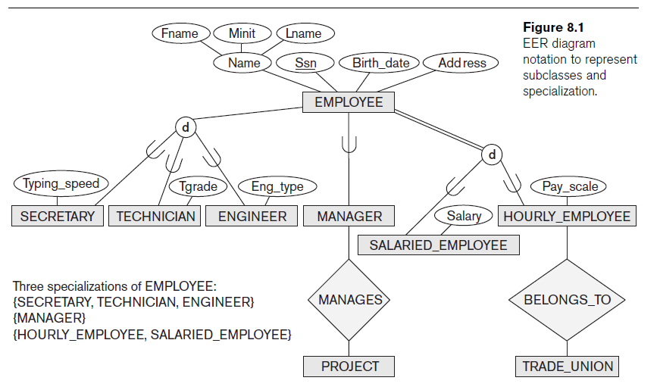

Slide 10
Subclasses and Superclasses (2)
Each of these subgroupings is a subset of EMPLOYEE entities
Each is called a subclass of EMPLOYEE
EMPLOYEE is the superclass for each of these subclasses
These are called superclass/subclass relationships:
EMPLOYEE/SECRETARY
EMPLOYEE/TECHNICIAN
EMPLOYEE/MANAGER
…

Slide 11
Subclasses and Superclasses (3)
These are also called IS-A relationships
SECRETARY IS-A EMPLOYEE, TECHNICIAN IS-A EMPLOYEE, ….
Note: An entity that is member of a subclass represents the same real-world entity as some member of the superclass:
The subclass member is the same entity in a distinct specific role
An entity cannot exist in the database merely by being a member of a subclass; it must also be a member of the superclass

Slide 12
Subclasses and Superclasses (4)
Examples:
A salaried employee who is also an engineer belongs to the two subclasses:
ENGINEER, and
SALARIED_EMPLOYEE
A salaried employee who is also an engineering manager belongs to the three subclasses:
MANAGER,
ENGINEER, and
SALARIED_EMPLOYEE
It is not necessary that every entity in a superclass be a member of some subclass

Slide 13
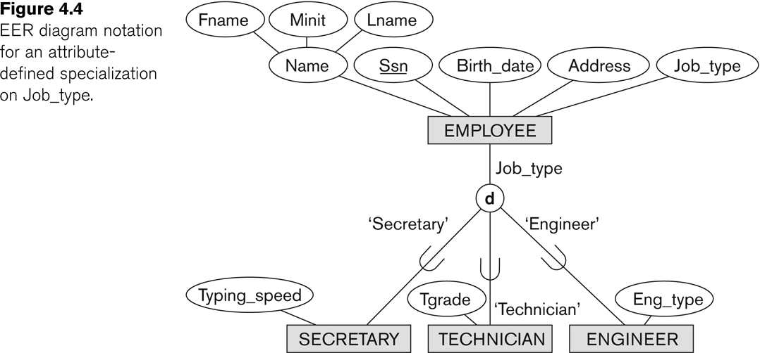
Representing Specialization in EER Diagrams

Slide 14
Attribute Inheritance in Superclass / Subclass Relationships
An entity that is member of a subclass inherits
All attributes of the entity as a member of the superclass
All relationships of the entity as a member of the superclass
Example:
In the previous slide, SECRETARY (as well as TECHNICIAN and ENGINEER) inherit the attributes Name, SSN, …, from EMPLOYEE
Every SECRETARY entity will have values for the inherited attributes

Slide 15
Specialization (1)
Specialization is the process of defining a set of subclasses of a superclass
The set of subclasses is based upon some distinguishing characteristics of the entities in the superclass
Example: {SECRETARY, ENGINEER, TECHNICIAN} is a specialization of EMPLOYEE based upon job type.
May have several specializations of the same superclass

Slide 16
Specialization (2)
Example: Another specialization of EMPLOYEE based on method of pay is {SALARIED_EMPLOYEE, HOURLY_EMPLOYEE}.
Superclass/subclass relationships and specialization can be diagrammatically represented in EER diagrams
Attributes of a subclass are called specific or local attributes.
For example, the attribute TypingSpeed of SECRETARY
The subclass can also participate in specific relationship types.
For example, a relationship BELONGS_TO of HOURLY_EMPLOYEE

Slide 17
Specialization and Generalization
Specialization
Process of defining a set of subclasses of an entity type
Defined on the basis of some distinguishing characteristic of the entities in the superclass
Subclass can define:
Specific attributes (local attributes)
Specific relationship types

Slide 18
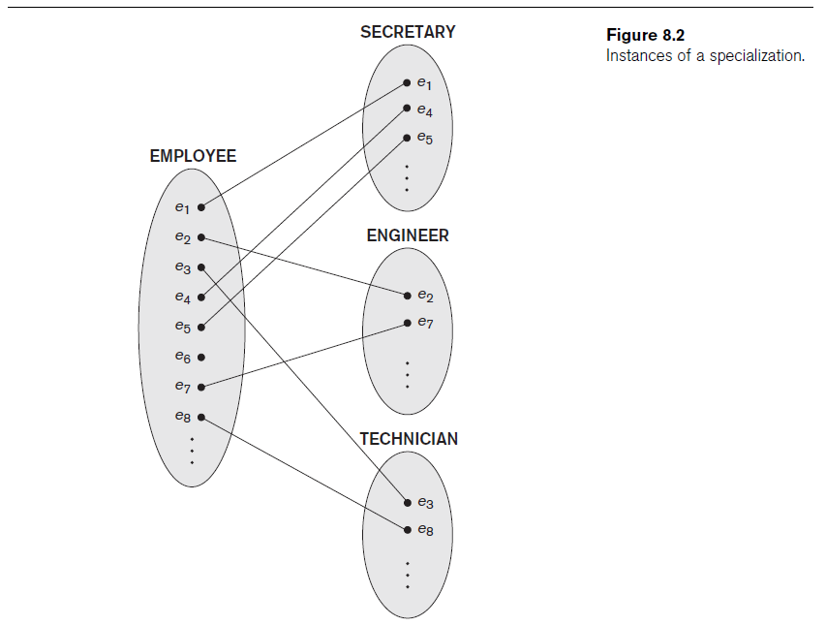

Slide 19
Generalization
Reverse process of abstraction
Generalize into a single superclass
Identify their common features
Original entity types are special subclasses
Generalization
Process of defining a generalized entity type from the given entity types

Slide 20
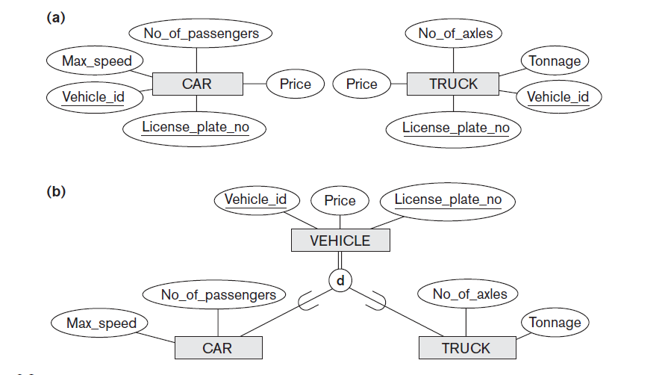
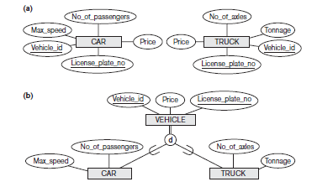

Slide 21
Constraints and Characteristics
Constraints that apply to a single specialization or a single generalization
Differences between specialization/
generalization lattices and hierarchies

Slide 22
Constraints on Specialization and Generalization (1)
If we can determine exactly those entities that will become members of each subclass by a condition, the subclasses are called predicate-defined (or condition-defined) subclasses
Condition is a constraint that determines subclass members
Display a predicate-defined subclass by writing the predicate condition next to the line attaching the subclass to its superclass

Slide 23
Constraints on Specialization and Generalization (2)
If no condition determines membership, the subclass is called user-defined
Membership in a subclass is determined by the database users by applying an operation to add an entity to the subclass
Membership in the subclass is specified individually for each entity in the superclass by the user

Slide 24
Displaying an attribute-defined specialization in EER diagrams

Slide 25
Constraints on Specialization and Generalization (3)
Two basic constraints can apply to a specialization/generalization:
Disjointness Constraint:
Completeness Constraint:

Slide 26
Constraints on Specialization and Generalization (4)
Disjointness Constraint:
Specifies that the subclasses of the specialization must be disjoint:
an entity can be a member of at most one of the subclasses of the specialization
Specified by d in EER diagram
If not disjoint, specialization is overlapping:
that is the same entity may be a member of more than one subclass of the specialization
Specified by o in EER diagram

Slide 27
Constraints on Specialization and Generalization (5)
Completeness Constraint:
Total specifies that every entity in the superclass must be a member of some subclass in the specialization/generalization
Shown in EER diagrams by a double line
Partial allows an entity not to belong to any of the subclasses
Shown in EER diagrams by a single line

Slide 28
Constraints on Specialization and Generalization (6)
Hence, we have four types of specialization/generalization:
Disjoint, total
Disjoint, partial
Overlapping, total
Overlapping, partial
Note: Generalization usually is total because the superclass is derived from the subclasses.

Slide 29
Example of disjoint partial Specialization

Slide 30
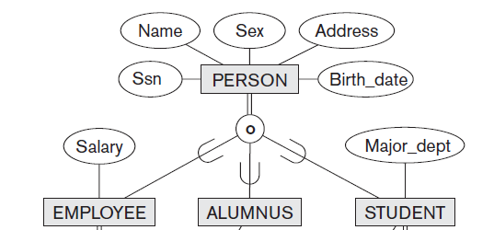
Example of overlapping total Specialization

Slide 31
Specialization/Generalization Hierarchies, Lattices & Shared Subclasses (1)
A subclass may itself have further subclasses specified on it
forms a hierarchy or a lattice
Hierarchy has a constraint that every subclass has only one superclass (called single inheritance); this is basically a tree structure
In a lattice, a subclass can be subclass of more than one superclass (called multiple inheritance)

Slide 32
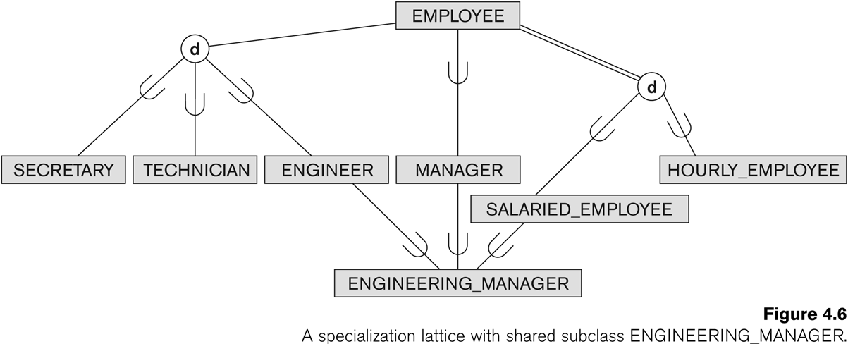
Shared Subclass “Engineering_Manager”

Slide 33
Specialization/Generalization Hierarchies, Lattices & Shared Subclasses (2)
In a lattice or hierarchy, a subclass inherits attributes not only of its direct superclass, but also of all its predecessor superclasses
A subclass with more than one superclass is called a shared subclass (multiple inheritance)
One shared sub class- Lattice
No shared subclass – Hierarchy
We just use specialization (to stand for the end result of either specialization or generalization)

Slide 34
Specialization/Generalization Hierarchies, Lattices & Shared Subclasses (3)
In specialization, start with an entity type and then define subclasses of the entity type by successive specialization
called a top down conceptual refinement process
In generalization, start with many entity types and generalize those that have common properties
Called a bottom up conceptual synthesis process
In practice, a combination of both processes is usually employed

Slide 35
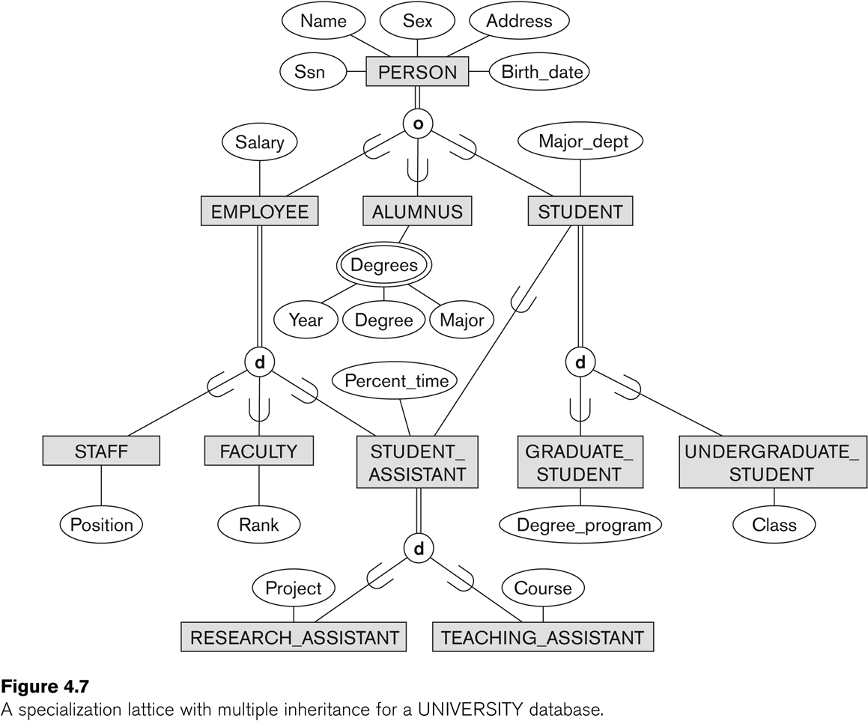
Specialization / Generalization Lattice Example (UNIVERSITY)

Slide 36
Summary
EER
Sub/super class-Inheritance
Specialization and Generalization
Constraints and Characteristics

